Slide 1

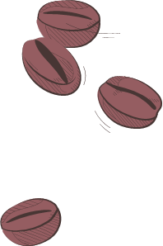
Will & Lou’s Café Problem
22
01
25
An Exhibit of Creative Coding Projects !

Slide 2


Introduction
Course Title | Operating Systems
Course Code | CSE325
Section | 02
Semester | Fall 2024
Course Instructor | Dr. Md. Nawab Yousuf Ali Professor Department of CSE
Group: 09
Name | ID | Roll
Abrar Hossain Zahin | 2022-2-60-040 | 22

Slide 3
TABLE OF CONTENTS
01
02
03
Problem
The Café Problem!
Solution
Implementation
How System Works !
04
05
06
Output
Limitations
Conclusion

Slide 4
01
The Problem
How Our Café Works !

Slide 5
The Problem
Suppose, ‘Will and Lou’ are planning to open a charming café where customers can enjoy reading books while dining. To provide a seamless experience for every customer. So we’ve designed a system with the following guidelines :
A customer may enter the café only if a table is available for them to sit.
The system will maintain a record of book borrowing and returning to efficiently manage the book inventory.
Once customers have finished reading, eating, or drinking, they should vacate the table, allowing new customers to use it.

Slide 6

The Solution
02

Slide 7
The Solution
To build our system, we are utilizing Threads, Mutexes, and Semaphores.
Mutexes are used to handle shared resources like the book inventory and tables, ensuring that customers can borrow books or occupy a table only when a seat is available.
Semaphores are employed to regulate the flow of customers and coordinate their activities, such as finding a table, borrowing a book, and exiting the café.
By integrating these components, we establish a well-organized system for "Will and Lou's" Café.

Slide 8
Solution - Flowchart
Start
Setup Books
Setup Tables
Open Café
No
Yes
Let In ?
Close Café
Exit Café
Borrow Book
Take Seat

Slide 9

Implementation How The System Works !
03

Slide 10


Implementation
MAX_BOOK = 10
1
2
3
4
5
6
7
8
9
10
Book_Mutex
Table_Mutex
1
2
3
4
5
MAX_TABLE = 5

Slide 11

Implementation
MAX_BOOK = 10
1
2
3
4
5
6
7
8
9
10
Book_Mutex
Table_Mutex
3
4
1
2
Customer Mutex
1
2
3
4
5
MAX_TABLE = 5

Slide 12
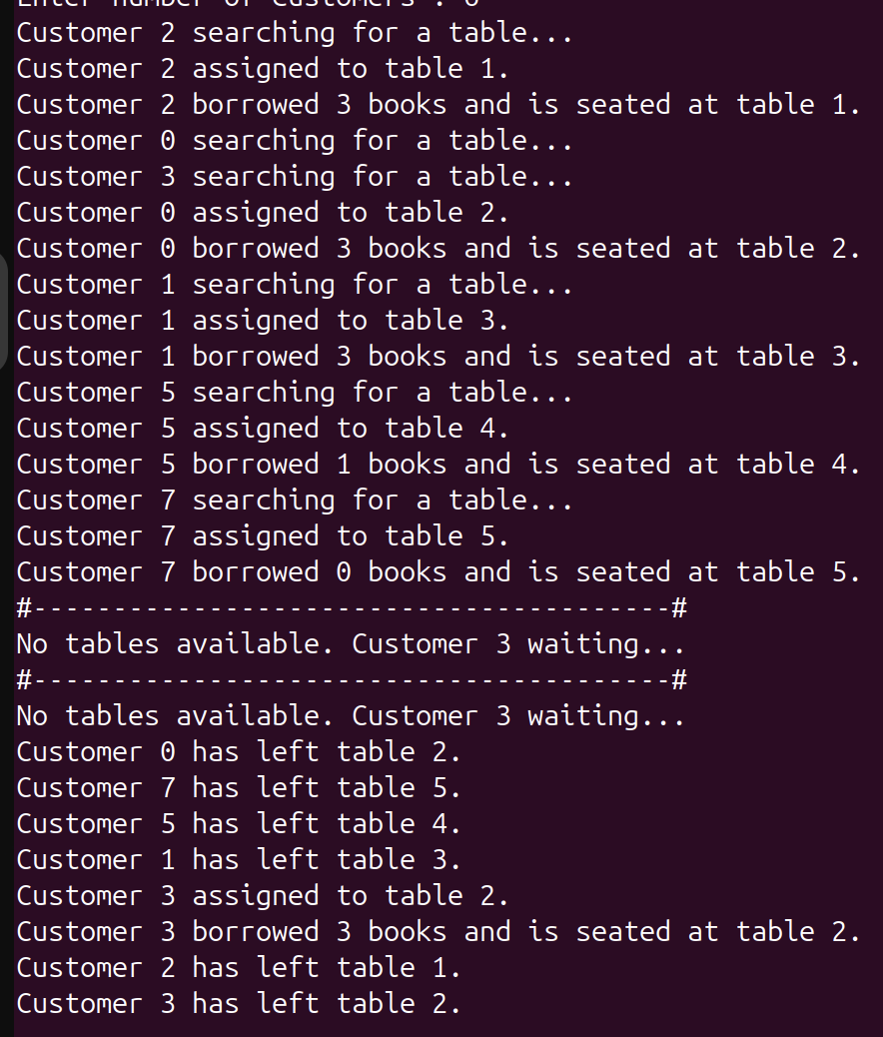
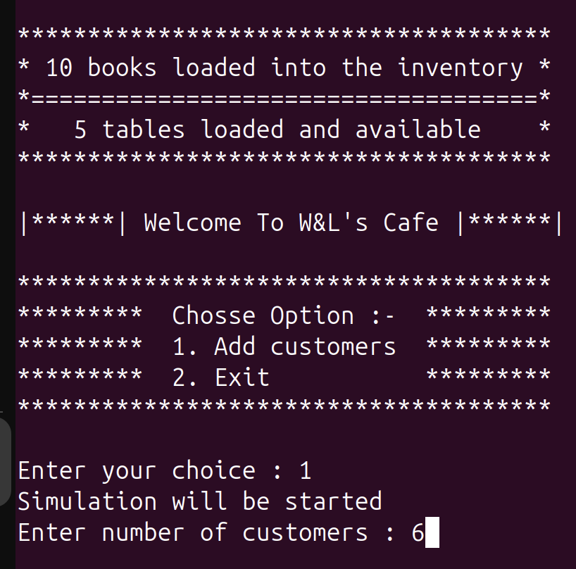
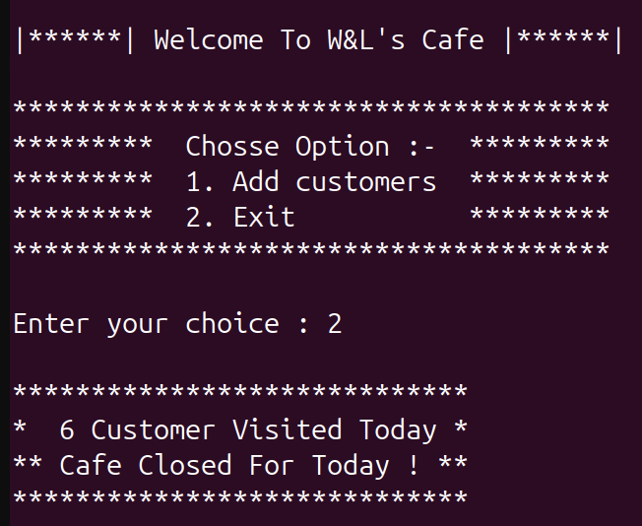
Output
04

Slide 13
Limitation
05
No Timeout for Waiting: Customers wait indefinitely for tables, with no timeout mechanism to leave the queue after prolonged waiting.
Concurrency Conflicts: Insufficient optimization for managing concurrent access to resources (e.g., overlapping book assignments under heavy load).
Unoptimized Queue Management: The system lacks customer prioritization or termination logic if tables remain unavailable.
Fixed Resource Limits: The hardcoded number of books and tables restricts scalability. Allowing dynamic resource adjustment could overcome this.
Limited Error Handling: The program doesn't validate or handle exceptional scenarios system resource exhaustion effectively.

Slide 14
Conclusion
06
Our system provides a fundamental multi-threaded approach to managing tables and books, utilizing semaphores and mutexes effectively. It ensures customers are assigned tables and books and allows them to exit after their allotted time. However, the lack of dynamic interfaces limits the system's potential. Enhancing these aspects could make the simulation more realistic and efficient, aligning it more closely with a real-world café environment.

Slide 15
Thank You
Everyone

